Slide 1
Capstone Project — The Battle of Neighborhoods in New York City: Indian Restaurants

Slide 2
Introduction
New York City is the most populous city in United States and one of the important cities in the world. It is the cultural, financial and media capital of the world. It influences many domains like fashion, education, politics, trade and commerce, entertainment, tourism, art and sports.It is composed of five boroughs Brooklyn, Queens, Manhattan, The Bronx and Staten Island.Manhattan is the smallest and most densely populated borough.
NYC is a home to several ethnicities of which the Indians constitute one of the largest and fastest growing ethnicities. The Asian Indian population has been growing rapidly.NYC is a home to several restaurants ranging from family owned to Michelin starred restaurants. Of these there are a good number of Indian restaurants too.

Slide 3
Stakeholders:
Business owners: Say a person wants to start a new Indian restaurant. Obviously, there are several factors that a person needs to consider in addition to the budget. The most import is the location. Some of the factors to consider while choosing the location are
Best to open the new restaurant away from already highly successful restaurants.
Best to open restaurants near famous sites like tourist sites, transit hubs, parks etc. since it can attract more people.
Identifying work districts to attract office goers for lunch/dinner
Tourism companies: Tourists are often lost in a big city. It would be helpful for the tourism companies to obtain some statistics information and provide to their customers.

Slide 4
DataSources
Datasources :
https://cocl.us/new_york_dataset: provides information on New York city
Foursquare APIs:By using this API we will get all the Indian restaurants at a particular location/neighborhood/borough and its details . This can be used for statistical analysis
Geopy library: geopy offers geocoding web services. We can locate the latitude and longitude of various locations using third-party geocoders and other data sources. We import the Nominatim library, chose Nominatim geocoder, and create a new instance of it
Folium library: This is used to visualize the geographic details of New York city and to show the locations of the various restaurants

Slide 5
Methodology: Data Preparation
Many usecases have been handled in this project. After obtaining data its very important to prepare it for analysis. Foursquare API call has been made and JSON data returned. Further data has been extracted into pandas dataframe and cleaned to hold only relevant columns. Folium has been used to visualize the restaurant locations .

Slide 6
fetchGeoCoordinates() is an important function in my project used to obtain latitude and longitude information
of a given address
def fetchGeoCoordinates(address): print(address) geolocator = Nominatim(user_agent="foursquare_agent") location = geolocator.geocode(address) latitude = location.latitude longitude = location.longitude print(latitude, longitude) return latitude,longitude

Slide 7
fetchRestaurants(): fetches the JSON data based on provided latitude longitude and JSON data is parsed to extract information into Pandas dataframe
def fetchRestaurants(latitude,longitude): search_query = 'Indian' radius = 5000 print(search_query + ' .... OK!') url = 'https://api.foursquare.com/v2/venues/search?client_id={}&client_secret={}&ll={},{}&oauth_token={}&v={}&query={}&radius={}&limit={}'.format(CLIENT_ID, CLIENT_SECRET, latitude, longitude,ACCESS_TOKEN, VERSION, search_query, radius, LIMIT) print(url) results = requests.get(url).json() # assign relevant part of JSON to venues venues = results['response']['venues'] # tranform venues into a dataframe dataframe = json_normalize(venues) dataframe_filtered=process_dataFrame(dataframe) Indian_rest_df=dataframe_filtered[(dataframe_filtered.categories=='Indian Restaurant')] return Indian_rest_df

Slide 8
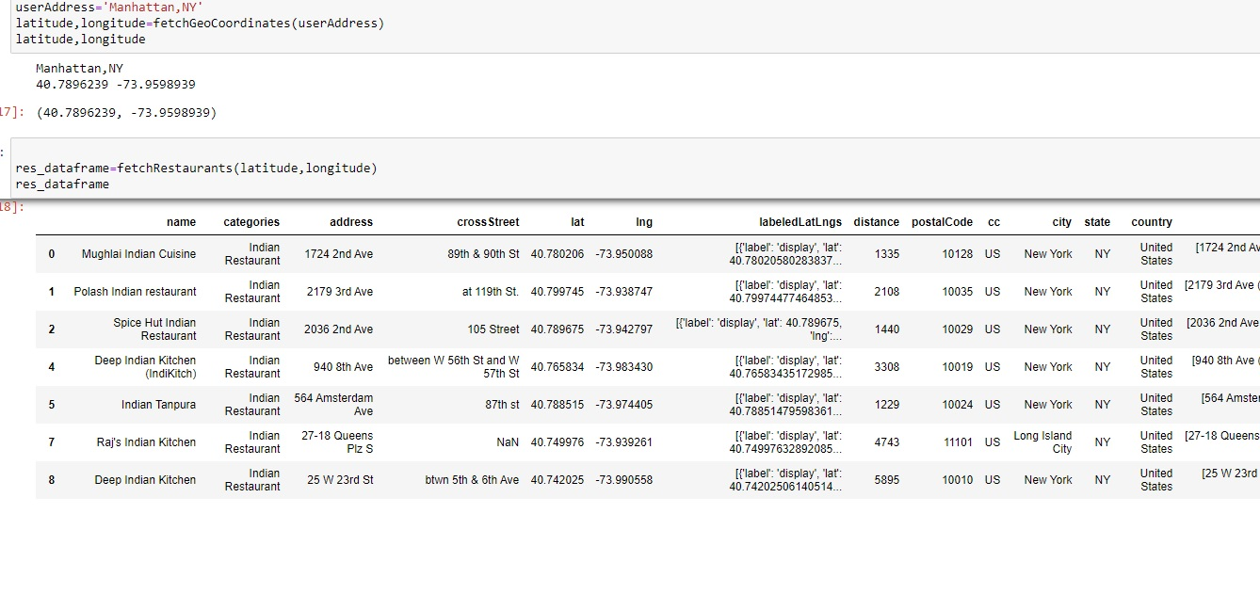
Restaurant data around a given location is captured to be analysed.
The pandas data frame will look like below. The data for a location is obtained

Slide 9
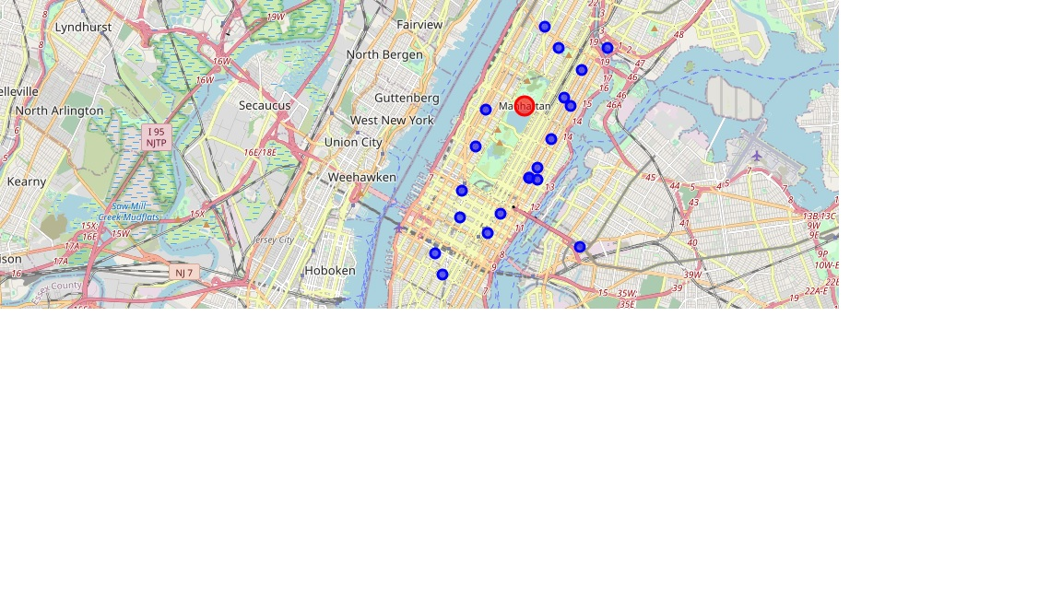
Folium library is used to visualize the locations.

Slide 10
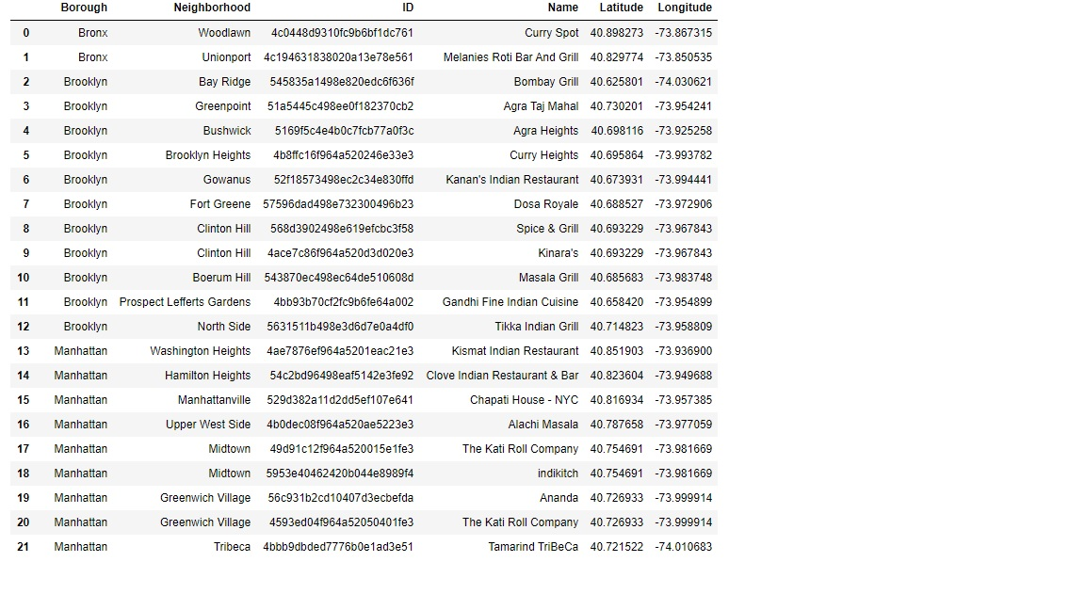
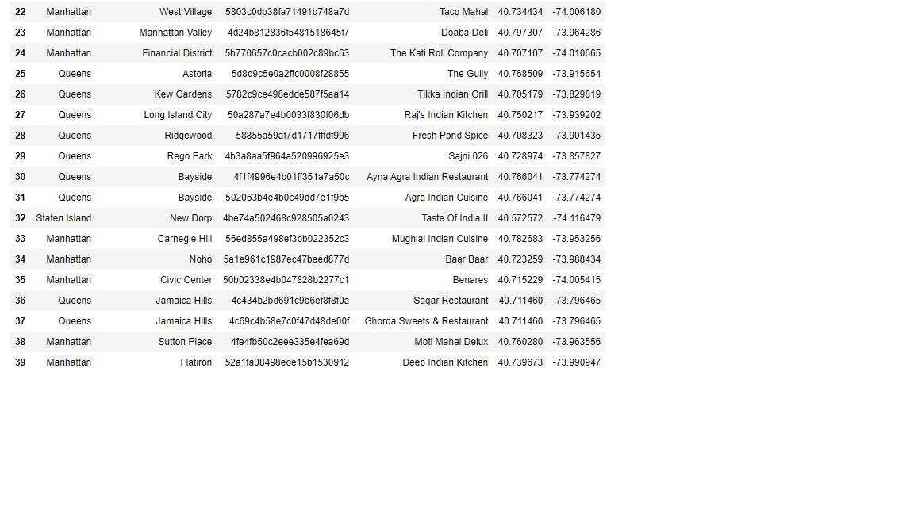
Analysis of all Indian restaurants in New York city: Once again the foursquareAPI is employed to collect data and Pandas frame is constructed based on it

Slide 11
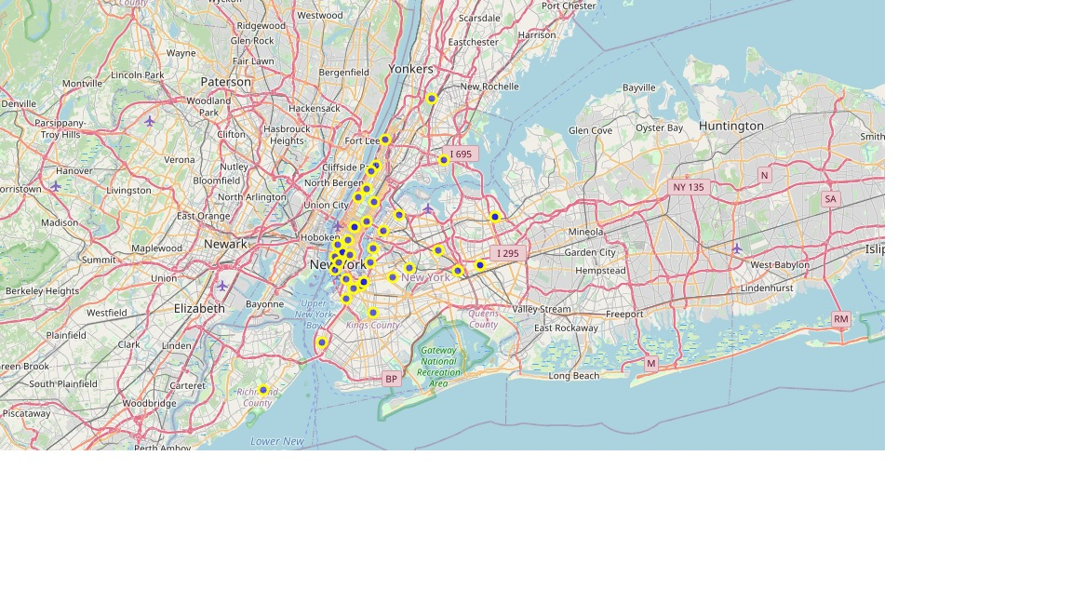

Slide 12
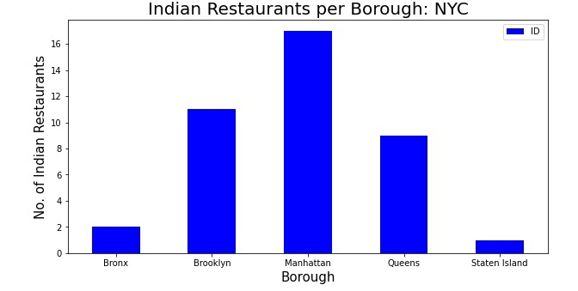
A bar graph has been plotted to give a snapshot of the Indian restaurant spread across the boroughs

Slide 13
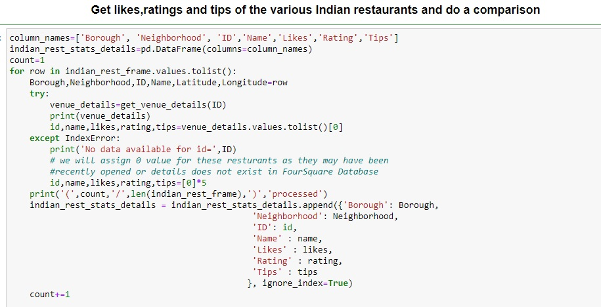
FoursquareAPi has been used to obtain data like tips , ratings etc to decide the top ones.

Slide 14
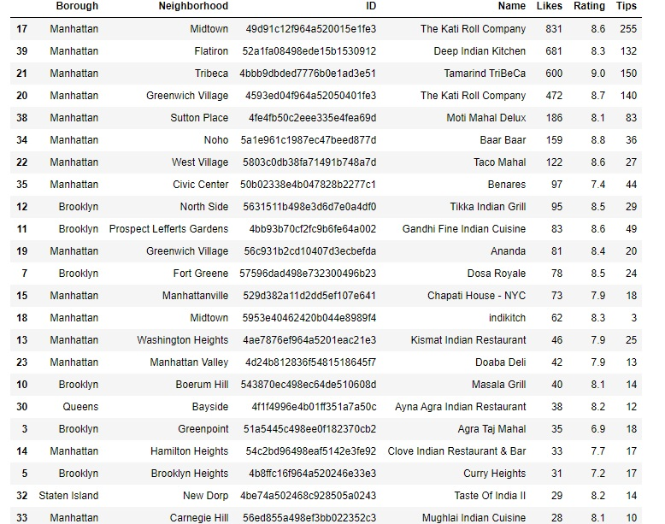

Slide 15
Results and Discussion
Results
We got to study the distribution of Indian restaurants in NYC and were able to make some inferences which will be useful to both travelers and persons having business interest in Indian restaurants in NYC. Let’s summarize our findings:
Manhattan is the borough in NYC that has least number of neighborhoods.
Manhattan has the maximum number of Indian restaurants.
Staten Island has the least number of Indian restaurants.
The Katti roll Company in Manhattan has the most number of likes.
Tamarind Tribeca in Manhattan has the highest rating.
Discussion:
In further analysis we can explore more data facts about restaurants like menu, prices, convenience to reach from important locations etc. Also, we are highly dependent on the accuracy of Foursquare data.
Maybe census data also can be employed to obtain facts which can play another factor.

Slide 16
Conclusion
In todays world, data and its analysis can be used to find the solutions to many problems.
Like seen in this project, we could project the distribution of the various Indian restaurants and its locations across the boroughs of new York city. These results can help tourism companies and persons with business interest. In the world before analytics, businesses would not thrive only because of gap in knowledge..
Python has some excellent libraries to explore and analyze data.
Foursquare API and Folium has also been used to do exploration and analysis of data .
Github Link: https://github.com/Jaz-1999/Coursera_Capstone/blob/main/Capstone%20Project_%20The%20Battle%20of%20Neighborhoods.ipynb

